Slide 1

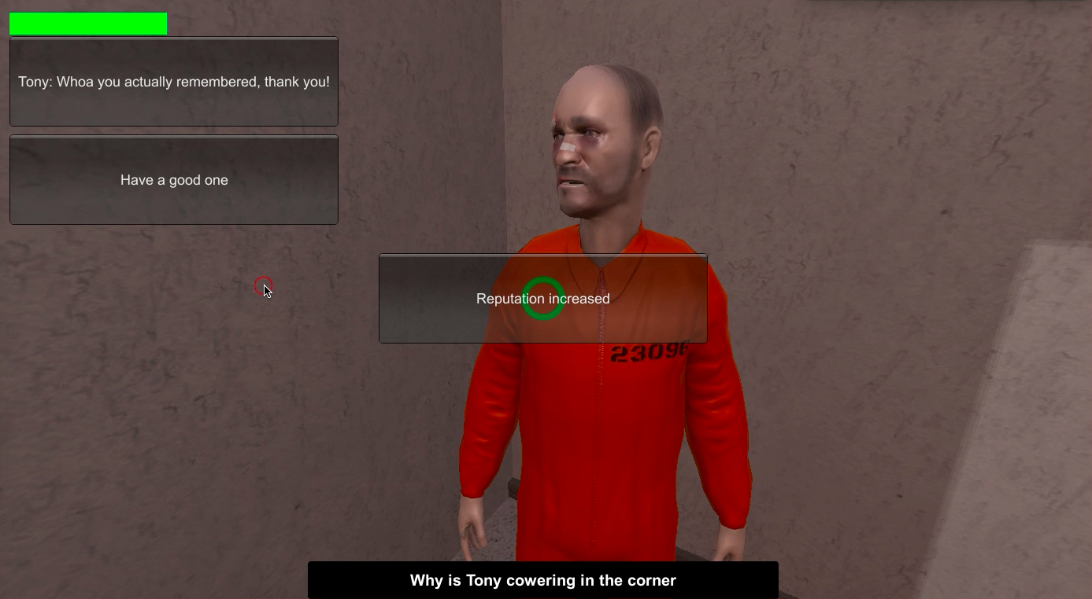
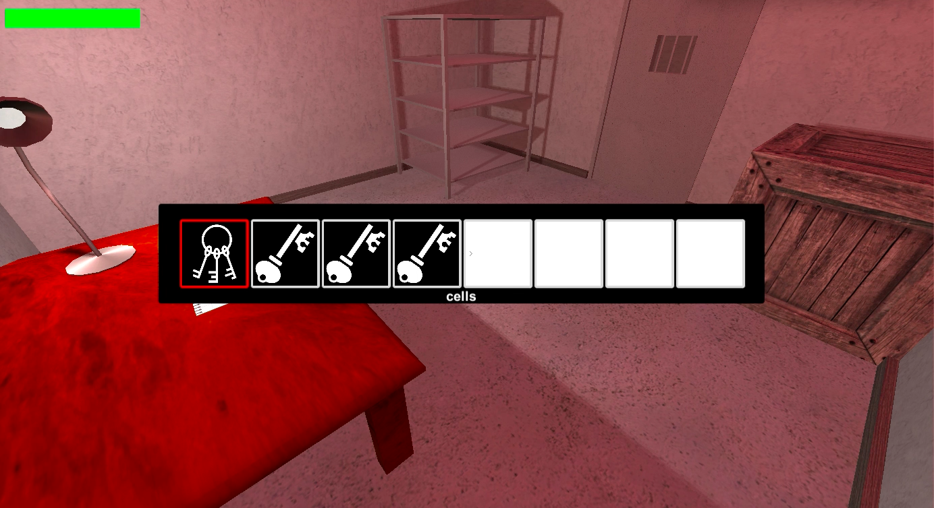
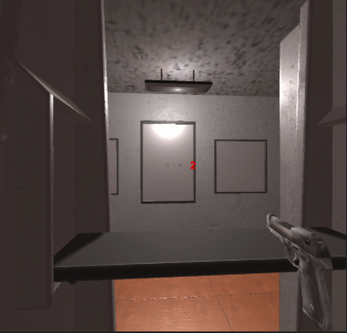
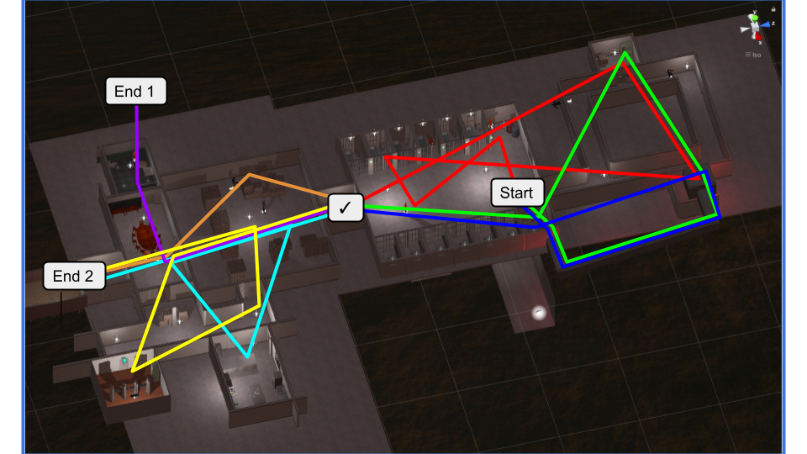
Who Framed Roger Crawfis?
Roger Crawfis (Instr.), Chance L., John P., Steven P., Alice S., Aishwarya S., Bob Y., Zicong Z.
–
DEPARTMENT OF COMPUTER SCIENCE AND ENGINEERING
Introduction
Who Framed Roger Crawfis? (WFRC) is a first person 3D game that follows Roger Crawfis, a local computer graphics expert, who has been wrongfully convicted for murder and sent to prison. He must break out so he can find the evidence that exonerates him and prove his innocence. He can do so with the help of other inmates and correctional officers by exchanging goods and forming alliances, and gathering information that can help him plan his escape.
WFRC is built in Unity 3D. The keyboard controls move the player to different locations and allow it to interact with objects, guards, and other inmates. An inventory keeps track of all items collected, that can be exchanged for information or other items. Mechanics include walking, jumping, crouching, melee combat, and aiming and shooting guns. There are multiple ways to complete the game, all of which require puzzle solving, building rapport among other characters, and stealth.
Other Features
Inventory
Each new game starts with a blank inventory that can store items that can be collected throughout the game. For instance, when the player finds a key for the correctional officers’ quarters, it is added to the inventory. Some items stay in the inventory forever, like keys. However, some items are removed when they are used (cake slices).
.
Saying nice things to inmates builds your reputation with them.
Non-Player Characters
Inmates
Some inmates are simple characters in the background, and others can interact with the player. This conversation is supported by a dialogue system, which is an XML tree that represents a dialogue and it’s various responses. Throughout the conversation, the player can build a reputation with an inmate by either presenting them with a gift, or by saying nice things to them. This reputation lasts throughout the game.
Guards
All guards are interactive. While most do not converse with the player, they do approach the player if they catch him at a location he is not supposed to be at. The guards are AI agents that walk around and approach the player as soon as he comes in their range of vision. Once they reach the player, they fight him till he either fights back and kills them, or they send the player back to where he started. The player can also build their reputation by interacting with guards.
Multi-path gameplay
The game offers multiple ways to get from one point to the next point in the level. This is done to incorporate many mechanics in one game and have each play of the game be different from the last. This was achieved by expanding the level to many rooms, with secret passage ways and multiple escape points and endings. Each path differs from the other in terms of location, NPC interaction, and reputation.
A view of the inventory mid-game.
Stealth
Throughout the game, the player has various opportunities to use physical combat. The shooting mechanic can be used to either fight guards, or for target practice. The camera has a permanent crosshair that helps with better aiming. The position of the crosshair determines the aim of the shot. Melee can also be used for attacking objects and enemies
A shooting mini-game that helps win reputation points.
Some of the paths to finish the game.

